Slide 1
MLE CAPSTONE PRESENTATION BINARY CLASSIFICATION MODELS FOR LOAN DEFAULT PREDICTION
GROUP 1
Bhagavan Adusumilli
Karthik Srinivasan
Lu Zheng
Manjula Ibrahim

Slide 2
BUSINESS PROBLEM
Consumer loans delinquency rates has been rising since May’22 (Q1,23: 2.22 to 2.36 in Q2,23); Write offs could cost in billions of dollars
Predicting which loans will default is important to financial institutions
Dataset & Strategy: Kaggle dataset on loan defaults chosen, data reviewed and pre-processed, binary classification models built to predict loan defaults. A UI also built to predict default based on user input of required data fields
https://www.kaggle.com/datasets/hemanthsai7/loandefault/data
Notes:
https://www.federalreserve.gov/releases/chargeoff/delallsa.htmP
https://www.pymnts.com/credit-cards/2023/bank-of-america-and-jpmorgan-chase-report-rising-delinquencies/
Feb 15, 2023
JPMorgan Chase said that during those same months, its credit card delinquency rate rose from 0.76% to 0.83% but its net charge-off rate dipped from 1.24% to 1.17%,
Total Household Debt Reaches $17.06 Trillion in Q2 2023; Credit Card Debt Exceeds $1 Trillion
https://www.newyorkfed.org/newsevents/news/research/2023/20230808
What does delinquency mean in banking?
Being delinquent refers to the state of being past due on a debt. Delinquency occurs as soon as a borrower misses a payment on a loan, which can affect their credit score. Delinquency rates are used to show how many accounts in a financial institution's portfolio are delinquent.

Slide 3
PRE-PROCESSING, EDA
Missing data
Outliers
Resampling
Feature selection
Categorical, Numeric
Feature Category Removal
Reduce Feature Category
Duplicate Data
Rename Feature Names
Feature Name Case Conversion
Categorical Data Encoding
Count Encoder
Target Encoder
Notes:
https://www.federalreserve.gov/releases/chargeoff/delallsa.htmP
https://www.pymnts.com/credit-cards/2023/bank-of-america-and-jpmorgan-chase-report-rising-delinquencies/
Feb 15, 2023
JPMorgan Chase said that during those same months, its credit card delinquency rate rose from 0.76% to 0.83% but its net charge-off rate dipped from 1.24% to 1.17%,
Total Household Debt Reaches $17.06 Trillion in Q2 2023; Credit Card Debt Exceeds $1 Trillion
https://www.newyorkfed.org/newsevents/news/research/2023/20230808
What does delinquency mean in banking?
Being delinquent refers to the state of being past due on a debt. Delinquency occurs as soon as a borrower misses a payment on a loan, which can affect their credit score. Delinquency rates are used to show how many accounts in a financial institution's portfolio are delinquent.

Slide 4
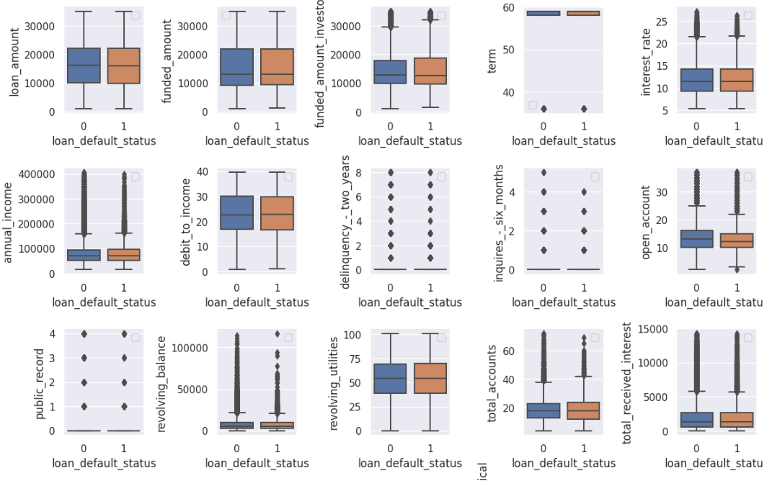
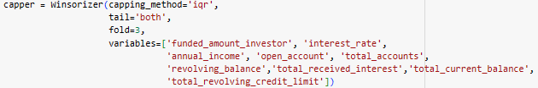
Outliers
Techniques Evaluated
Percentiles
Z-Score
IQR
Winsorize
Winsorize was used to cap the limit of outliers
Notes:
https://www.federalreserve.gov/releases/chargeoff/delallsa.htmP
https://www.pymnts.com/credit-cards/2023/bank-of-america-and-jpmorgan-chase-report-rising-delinquencies/
Feb 15, 2023
JPMorgan Chase said that during those same months, its credit card delinquency rate rose from 0.76% to 0.83% but its net charge-off rate dipped from 1.24% to 1.17%,
Total Household Debt Reaches $17.06 Trillion in Q2 2023; Credit Card Debt Exceeds $1 Trillion
https://www.newyorkfed.org/newsevents/news/research/2023/20230808
What does delinquency mean in banking?
Being delinquent refers to the state of being past due on a debt. Delinquency occurs as soon as a borrower misses a payment on a loan, which can affect their credit score. Delinquency rates are used to show how many accounts in a financial institution's portfolio are delinquent.

Slide 5
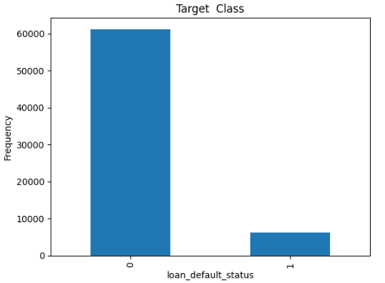
Resampling
Imbalanced Data
Bias towards Loan Non-Defaulters
9.25% in the dataset are Defaulters
SMOTE/MSMOTE
Notes:
https://www.federalreserve.gov/releases/chargeoff/delallsa.htmP
https://www.pymnts.com/credit-cards/2023/bank-of-america-and-jpmorgan-chase-report-rising-delinquencies/
Feb 15, 2023
JPMorgan Chase said that during those same months, its credit card delinquency rate rose from 0.76% to 0.83% but its net charge-off rate dipped from 1.24% to 1.17%,
Total Household Debt Reaches $17.06 Trillion in Q2 2023; Credit Card Debt Exceeds $1 Trillion
https://www.newyorkfed.org/newsevents/news/research/2023/20230808
What does delinquency mean in banking?
Being delinquent refers to the state of being past due on a debt. Delinquency occurs as soon as a borrower misses a payment on a loan, which can affect their credit score. Delinquency rates are used to show how many accounts in a financial institution's portfolio are delinquent.

Slide 6
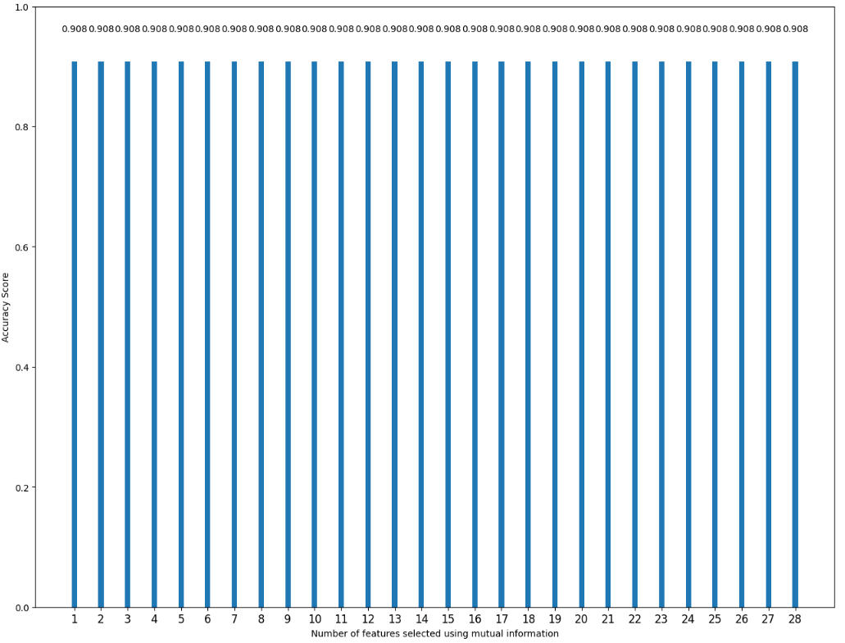
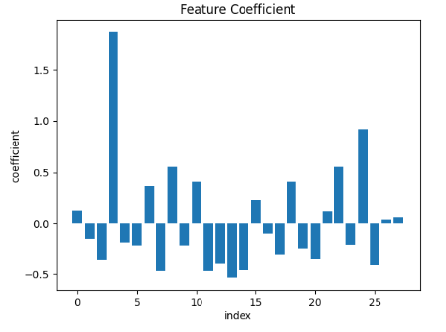
Feature Selection
Techniques Evaluated
Correlation
Chi2
Mutual Information
Risk Ratio
Feature Coefficients
Recursive Feature Elimination
Notes:
https://www.federalreserve.gov/releases/chargeoff/delallsa.htmP
https://www.pymnts.com/credit-cards/2023/bank-of-america-and-jpmorgan-chase-report-rising-delinquencies/
Feb 15, 2023
JPMorgan Chase said that during those same months, its credit card delinquency rate rose from 0.76% to 0.83% but its net charge-off rate dipped from 1.24% to 1.17%,
Total Household Debt Reaches $17.06 Trillion in Q2 2023; Credit Card Debt Exceeds $1 Trillion
https://www.newyorkfed.org/newsevents/news/research/2023/20230808
What does delinquency mean in banking?
Being delinquent refers to the state of being past due on a debt. Delinquency occurs as soon as a borrower misses a payment on a loan, which can affect their credit score. Delinquency rates are used to show how many accounts in a financial institution's portfolio are delinquent.

Slide 7
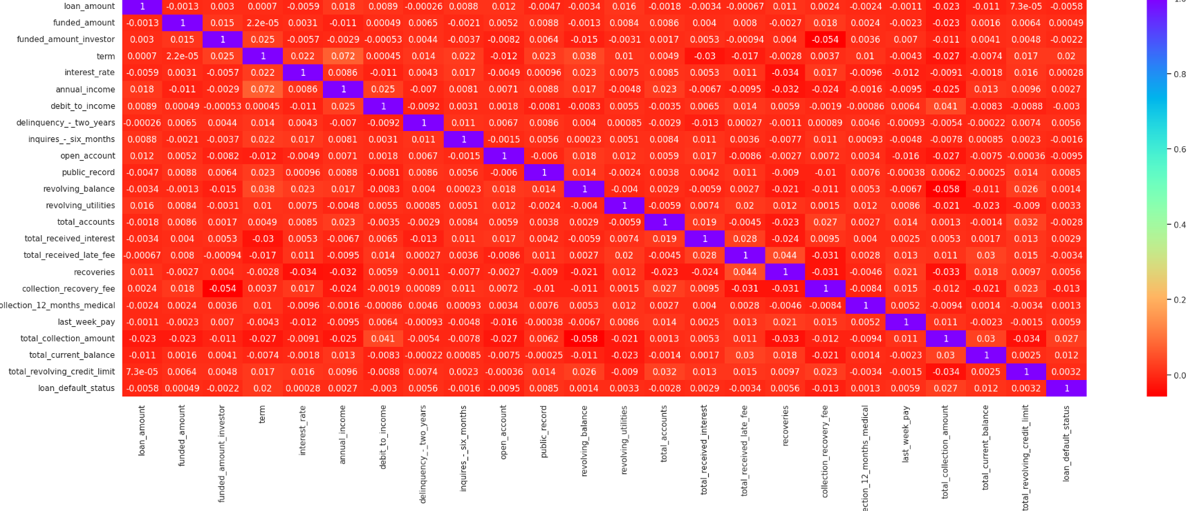
Feature Selection
Notes:
https://www.federalreserve.gov/releases/chargeoff/delallsa.htmP
https://www.pymnts.com/credit-cards/2023/bank-of-america-and-jpmorgan-chase-report-rising-delinquencies/
Feb 15, 2023
JPMorgan Chase said that during those same months, its credit card delinquency rate rose from 0.76% to 0.83% but its net charge-off rate dipped from 1.24% to 1.17%,
Total Household Debt Reaches $17.06 Trillion in Q2 2023; Credit Card Debt Exceeds $1 Trillion
https://www.newyorkfed.org/newsevents/news/research/2023/20230808
What does delinquency mean in banking?
Being delinquent refers to the state of being past due on a debt. Delinquency occurs as soon as a borrower misses a payment on a loan, which can affect their credit score. Delinquency rates are used to show how many accounts in a financial institution's portfolio are delinquent.

Slide 8
Model Development
Multiple binary classifiers have been tested
Neural Network(DNN)
Logistics Regression
XGBoost/Gradient Boosting/AdaBoost
Neural Network
Pros
Nonlinearity
Can handle unstructured data
Cons
Limited transparency and interoperability
Tendency of overfitting
Notes:
https://www.federalreserve.gov/releases/chargeoff/delallsa.htmP
https://www.pymnts.com/credit-cards/2023/bank-of-america-and-jpmorgan-chase-report-rising-delinquencies/
Feb 15, 2023
JPMorgan Chase said that during those same months, its credit card delinquency rate rose from 0.76% to 0.83% but its net charge-off rate dipped from 1.24% to 1.17%,
Total Household Debt Reaches $17.06 Trillion in Q2 2023; Credit Card Debt Exceeds $1 Trillion
https://www.newyorkfed.org/newsevents/news/research/2023/20230808
What does delinquency mean in banking?
Being delinquent refers to the state of being past due on a debt. Delinquency occurs as soon as a borrower misses a payment on a loan, which can affect their credit score. Delinquency rates are used to show how many accounts in a financial institution's portfolio are delinquent.

Slide 9
Model Development
Hyperparameter Tuning for Neural Network
Number of layer
Number of unit on each layer
Activation function : ReLu/Tanh
Learning rate
Regularization : We applied 20% dropout rate in the layers to avoid potential over-fitting.
Notes:
https://www.federalreserve.gov/releases/chargeoff/delallsa.htmP
https://www.pymnts.com/credit-cards/2023/bank-of-america-and-jpmorgan-chase-report-rising-delinquencies/
Feb 15, 2023
JPMorgan Chase said that during those same months, its credit card delinquency rate rose from 0.76% to 0.83% but its net charge-off rate dipped from 1.24% to 1.17%,
Total Household Debt Reaches $17.06 Trillion in Q2 2023; Credit Card Debt Exceeds $1 Trillion
https://www.newyorkfed.org/newsevents/news/research/2023/20230808
What does delinquency mean in banking?
Being delinquent refers to the state of being past due on a debt. Delinquency occurs as soon as a borrower misses a payment on a loan, which can affect their credit score. Delinquency rates are used to show how many accounts in a financial institution's portfolio are delinquent.

Slide 10
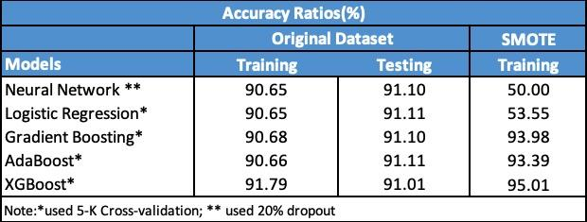
Model Performance
The accuracy ratios for neural network(NN) are ~90% in the training dataset and ~91% in the testing dataset.
The accuracy ratios of other models such as logistic regression are very close to NN.
Because of the dataset is imbalanced, we adopted SMOTE sampling in the training dataset and retrained all the models.
The accuracy ratios for NN and logistic regression decrease after using the SMOTE, but the performances of other boosting algorithms are slightly improved.
Ensemble methods(e.g., boosting) that combine multiple algorithms may overfit under over-sampling

Slide 11
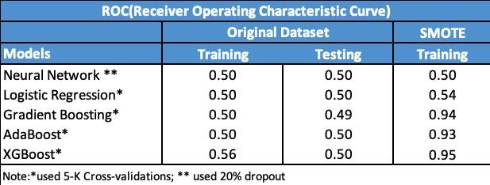
Model Performance
The separation power of a binary classifier is crucial. A useful model should be able to distinguish defaulters from non-defaulters.
We further tested ROC(Receiver Operating Characteristic Curve) for all the trained models.
As the table below shown, ROC is uniformly low across all the models we’ve trained in the original dataset.
Boosting with SMOTE seems have better ROC in the training dataset.
Next step: Gradient Boosting Neural Network(GrowNet) has been developed in 2022.

Slide 12
Conclusions and Takeaways
Our Exploratory Data Analysis (EDA) gave us directions in addressing outliers, and in feature engineering (ex: log normal transformation)
Imbalance data is a common problem in financial modeling, for example fraud detection, loan delinquency. We employed SMOTE technique to address this.
The results we found in the project highlight the importance of using multiple performance metrics in an imbalance dataset. (for example Confusion Matrix, Accuracy, ROC)
XGBoost gave the best ROC rates.
Feature of importance(XGBoost): Loan Debt Consolidation (XGBoost)

Slide 13
Appendix
Notes:
https://www.federalreserve.gov/releases/chargeoff/delallsa.htmP
https://www.pymnts.com/credit-cards/2023/bank-of-america-and-jpmorgan-chase-report-rising-delinquencies/
Feb 15, 2023
JPMorgan Chase said that during those same months, its credit card delinquency rate rose from 0.76% to 0.83% but its net charge-off rate dipped from 1.24% to 1.17%,
Total Household Debt Reaches $17.06 Trillion in Q2 2023; Credit Card Debt Exceeds $1 Trillion
https://www.newyorkfed.org/newsevents/news/research/2023/20230808
What does delinquency mean in banking?
Being delinquent refers to the state of being past due on a debt. Delinquency occurs as soon as a borrower misses a payment on a loan, which can affect their credit score. Delinquency rates are used to show how many accounts in a financial institution's portfolio are delinquent.

Slide 14
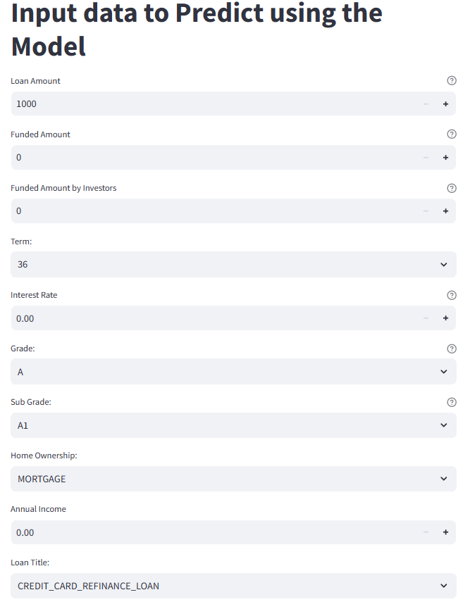
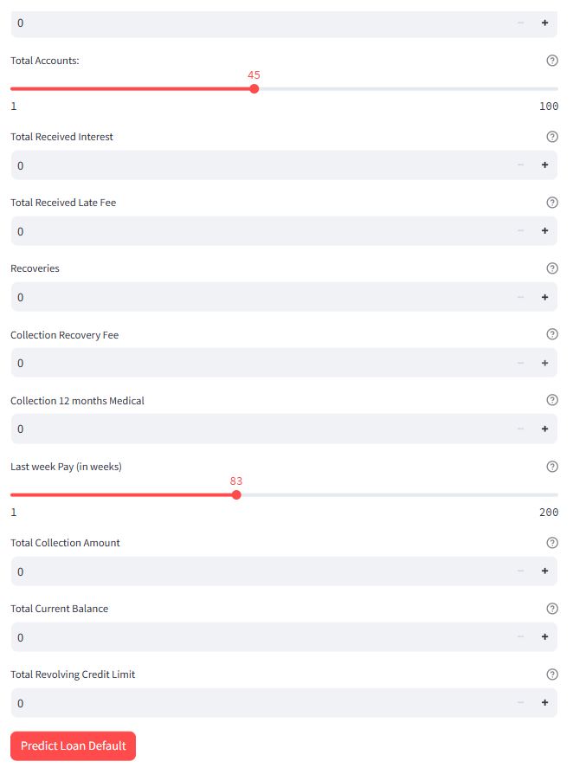
Model Test UI
Repository - https://github.com/skarskar/deploy
Notes:
https://www.federalreserve.gov/releases/chargeoff/delallsa.htmP
https://www.pymnts.com/credit-cards/2023/bank-of-america-and-jpmorgan-chase-report-rising-delinquencies/
Feb 15, 2023
JPMorgan Chase said that during those same months, its credit card delinquency rate rose from 0.76% to 0.83% but its net charge-off rate dipped from 1.24% to 1.17%,
Total Household Debt Reaches $17.06 Trillion in Q2 2023; Credit Card Debt Exceeds $1 Trillion
https://www.newyorkfed.org/newsevents/news/research/2023/20230808
What does delinquency mean in banking?
Being delinquent refers to the state of being past due on a debt. Delinquency occurs as soon as a borrower misses a payment on a loan, which can affect their credit score. Delinquency rates are used to show how many accounts in a financial institution's portfolio are delinquent.

Slide 15
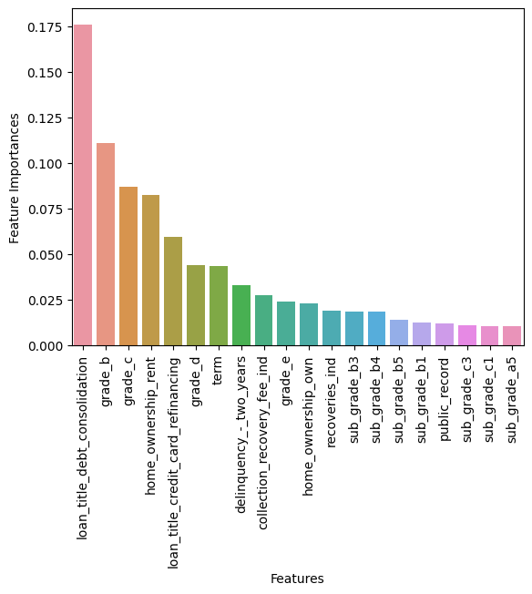
Appendix A: Variable Importances(XGBoost)

